Slide 1
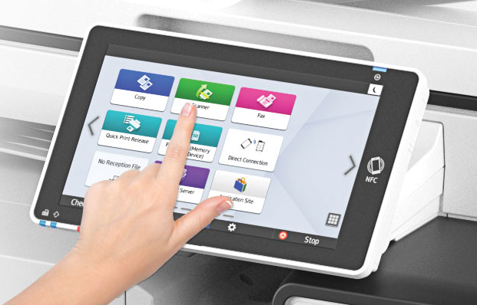
MFP/SOP
Cleaning Best Practices
March 2020

Slide 2
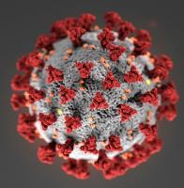
Recent Concerns
In light of the recent concerns with the COVID19 Corona Virus, everyone wants to know how best to clean their MFP screens and operation panels.
For generally information regarding the Coronavirus (COVID-19) visit the CDC’s website: https://www.cdc.gov/coronavirus/2019-ncov/about/transmission.html
Here are some recommendations

Slide 3
What Should I Avoid?
Avoid anything that contains:
Bleach
Ammonia
Other harsh cleaning solvents
The touch screen could eventually become clouded and require replacement

Slide 4
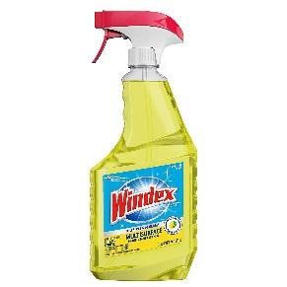
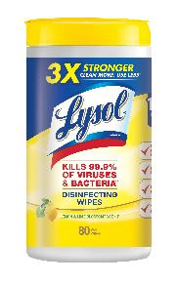
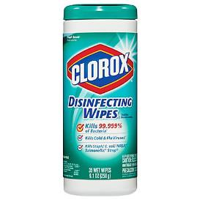
What Can I Use?
Most types of anti-bacterial wipes or sprays

Slide 5
Using a Spray Bottle?
Lightly moisten a cloth and gently wipe down the screen and panels
A lint-free microfiber cloth is recommended
Avoid paper towels as they may scratch
DO NOT spray directly on the device’s surfaces or components, as getting liquid inside the device could damage the internal components

Slide 6
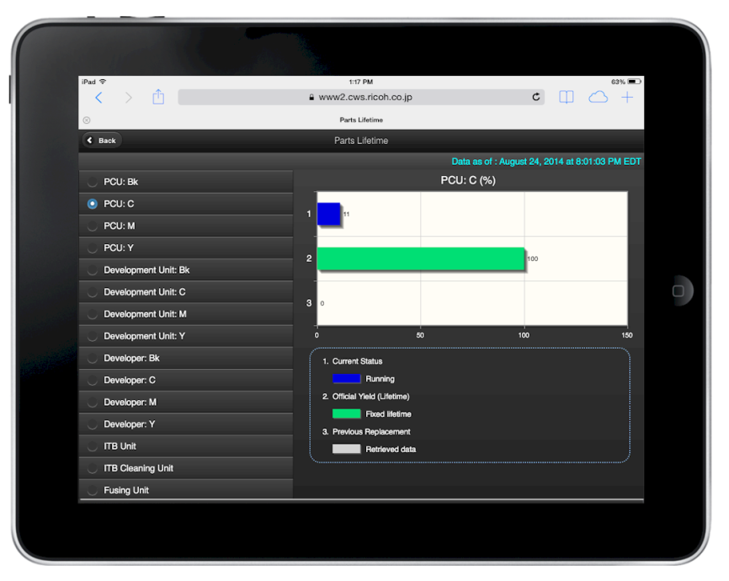
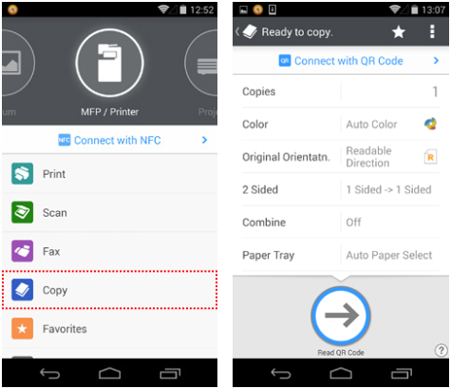
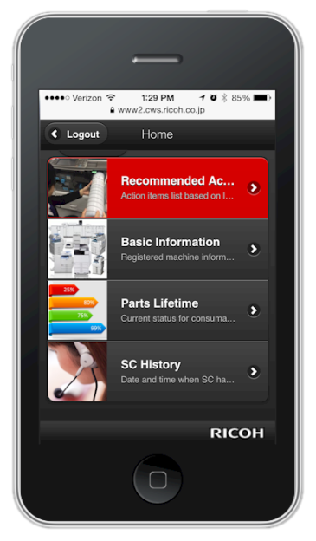
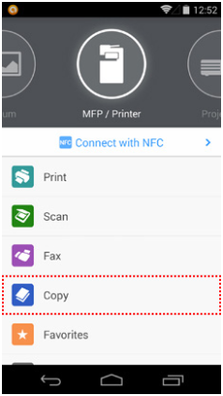
RICOH Smart Device Connector
“Too bad there wasn’t a way to operate the panel from my smart phone or tablet”
There is!!

Slide 7
RICOH Smart Device Connector
Allows you to operate the machine using a smart device
Copy
Print
Scan
Fax

Slide 8
RICOH Smart Device Connector
Copy settings can be specified
Number of copies
B&W or Color
Simplex or Duplex
Frequently used settings can be saved as favorites

Slide 9
RICOH Smart Device Connector
For more information
https://www.ricoh.com/software/connector
Available for free on Google Play and the App Store

Slide 10
Thank you.

